Slide 1
Android GUI
Università di Modena e Reggio Emilia
Prof. Nicola Bicocchi (nicola.bicocchi@unimore.it)

Slide 2
Summary
Now that we know the basic elements to create a small working application, let’s go into graphic aspects such as: what objects to show, where to place them, what they should look like
Manifest & Resources
Concepts on screens
Layout & attributes

Slide 3
XML
One of the greatest strengths of Android is the separation of the logic of the application from its appearance. We saw that each activity is associated with an xml file.
The XML language is a markup metalanguage, or a language based on a syntactic mechanism that allows you to define and control the meaning of the elements contained in a document or text. In Android, XML files are used to declare our graphical components. This is how Android keeps programming logic and design separate.
<tagName
Attribute:nameAttribute=“values”/>

Slide 4
AndroidManifest.xml
In addition to this, XML is used for an important file that defines all the features of our application: the Android manifest. Is a document that help to know which components are defined in our application. is composed by:
Permission: if our app require permission to use connection from internet, use camera, have access to phone contact read and write data all this permission are declared in it.
Definition of Activites.
Declaration API Level.
Also:
is responsible to protect the application to access any protected parts by providing the permissions.
It lists the instrumentation classes. The instrumentation classes provides profiling and other informations. These informations are removed just before the application is published etc.

Slide 5
Content
<?xml version="1.0" encoding="utf-8"?> <manifest xmlns:android="http://schemas.android.com/apk/res/android" xmlns:tools="http://schemas.android.com/tools" package="com.app">
<uses-permission android:name="android.permission.SEND_SMS"/> <uses-permission android:name="android.permission.INTERNET"/>
<uses-feature android:name="android.hardware.bluetooth" android:required="true"/>
<application android:allowBackup="true" android:dataExtractionRules="@xml/data_extraction_rules" android:fullBackupContent="@xml/backup_rules" android:icon="@mipmap/ic_launcher" android:label="@string/app_name" android:roundIcon="@mipmap/ic_launcher_round" android:supportsRtl="true" android:theme="@style/Theme.CustomToast" tools:targetApi="31"> <activity android:name=".MainActivity" android:exported="true"> <intent-filter> <action android:name="android.intent.action.MAIN" /> <category android:name="android.intent.category.LAUNCHER" /> </intent-filter> </activity> </application> </manifest>
<manifest>: represents the root element. It has package attribute that describes the package name that resolves any relative name of class in our package so we can write .NameActivity without having specifying the entire Activity path.

Slide 6
Content
<?xml version="1.0" encoding="utf-8"?> <manifest xmlns:android="http://schemas.android.com/apk/res/android" xmlns:tools="http://schemas.android.com/tools" package="com.app">
<uses-permission android:name="android.permission.SEND_SMS"/> <uses-permission android:name="android.permission.INTERNET"/>
<uses-feature android:name="android.hardware.bluetooth" android:required="true"/>
<application android:allowBackup="true" android:dataExtractionRules="@xml/data_extraction_rules" android:fullBackupContent="@xml/backup_rules" android:icon="@mipmap/ic_launcher" android:label="@string/app_name" android:roundIcon="@mipmap/ic_launcher_round" android:supportsRtl="true" android:theme="@style/Theme.CustomToast" tools:targetApi="31"> <activity android:name=".MainActivity" android:exported="true"> <intent-filter> <action android:name="android.intent.action.MAIN" /> <category android:name="android.intent.category.LAUNCHER" /> </intent-filter> </activity> </application> </manifest>
<manifest>: represents the root element. It has package attribute that describes the package name that resolves any relative name of class in our package so we can write .NameActivity without having specifying the entire Activity path.
<permission>: allow us to define permission needed to the application to do its job.

Slide 7
Content
<?xml version="1.0" encoding="utf-8"?> <manifest xmlns:android="http://schemas.android.com/apk/res/android" xmlns:tools="http://schemas.android.com/tools" package="com.app">
<uses-permission android:name="android.permission.SEND_SMS"/> <uses-permission android:name="android.permission.INTERNET"/>
<uses-feature android:name="android.hardware.bluetooth" android:required="true"/>
<application android:allowBackup="true" android:dataExtractionRules="@xml/data_extraction_rules" android:fullBackupContent="@xml/backup_rules" android:icon="@mipmap/ic_launcher" android:label="@string/app_name" android:roundIcon="@mipmap/ic_launcher_round" android:supportsRtl="true" android:theme="@style/Theme.CustomToast" tools:targetApi="31"> <activity android:name=".MainActivity" android:exported="true"> <intent-filter> <action android:name="android.intent.action.MAIN" /> <category android:name="android.intent.category.LAUNCHER" /> </intent-filter> </activity> </application> </manifest>
<manifest>: represents the root element. It has package attribute that describes the package name that resolves any relative name of class in our package so we can write .NameActivity without having specifying the entire Activity path.
<permission>: allow us to define permission needed to the application to do its job.
<feature>: allow us to declare hardware and software features to our app needs.

Slide 8
Content
<?xml version="1.0" encoding="utf-8"?> <manifest xmlns:android="http://schemas.android.com/apk/res/android" xmlns:tools="http://schemas.android.com/tools" package="com.app">
<uses-permission android:name="android.permission.SEND_SMS"/> <uses-permission android:name="android.permission.INTERNET"/>
<uses-feature android:name="android.hardware.bluetooth" android:required="true"/>
<application android:allowBackup="true" android:dataExtractionRules="@xml/data_extraction_rules" android:fullBackupContent="@xml/backup_rules" android:icon="@mipmap/ic_launcher" android:label="@string/app_name" android:roundIcon="@mipmap/ic_launcher_round" android:supportsRtl="true" android:theme="@style/Theme.CustomToast" tools:targetApi="31"> <activity android:name=".MainActivity" android:exported="true"> <intent-filter> <action android:name="android.intent.action.MAIN" /> <category android:name="android.intent.category.LAUNCHER" /> </intent-filter> </activity> </application> </manifest>
<manifest>: represents the root element. It has package attribute that describes the package name that resolves any relative name of class in our package so we can write .NameActivity without having specifying the entire Activity path.
<permission>: allow us to define permission needed to the application to do its job.
<feature>: allow us to declare hardware and software features to our app needs.
<application>: subitem of the manifest. It includes the namespace declaration, contains several subitem that declares the application component such as activity.

Slide 9
Content
<?xml version="1.0" encoding="utf-8"?> <manifest xmlns:android="http://schemas.android.com/apk/res/android" xmlns:tools="http://schemas.android.com/tools" package="com.app">
<uses-permission android:name="android.permission.SEND_SMS"/> <uses-permission android:name="android.permission.INTERNET"/>
<uses-feature android:name="android.hardware.bluetooth" android:required="true"/>
<application android:allowBackup="true" android:dataExtractionRules="@xml/data_extraction_rules" android:fullBackupContent="@xml/backup_rules" android:icon="@mipmap/ic_launcher" android:label="@string/app_name" android:roundIcon="@mipmap/ic_launcher_round" android:supportsRtl="true" android:theme="@style/Theme.CustomToast" tools:targetApi="31"> <activity android:name=".MainActivity" android:exported="true"> <intent-filter> <action android:name="android.intent.action.MAIN" /> <category android:name="android.intent.category.LAUNCHER" /> </intent-filter> </activity> </application> </manifest>
<manifest>: represents the root elemet. It has package attribute that describes the package name that resolves any relative name of class in our package so we can write .NameActivity without having specifying the entire Activity path.
<permission>: allow us to define permission needed to the application to do its job.
<feature>: allow us to declare hardware and software features to our app needs.
<application>: subitem of the manifest. It includes the namespace declaration, contains several subitem that declares the application component such as activity.
<activity>:for each app component that will be created in our app, we must declare a corresponding XML element in the manifest file. if an activity is not declared and there is reference to use it, the application crash.

Slide 10
Resources

Slide 11
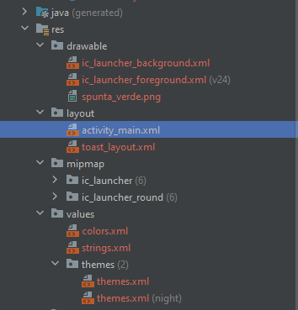
Structure
Resources in android are saved and organized in the root folder named res which contains several sub folders:
layout: it will contain the graphical architecture of the user interface components.
values: will contain strings, colors, dimensions and other types of values that can be used in additional resources or in the Java code. It is important to note that these values will constitute the content of appropriate XML tags (<string>, <dimension>, etc.) grouped in files with the name usually indicative: strings.xml, dimens.xml, colors.xml and so on. Such names are the result of pure convention, but the programmer can freely choose how to call them;
drawable: are images in the most common formats configured in XML;
mipmap: are images that constitute the icon of the application, the one with which it is launched from the operating system.

Slide 12
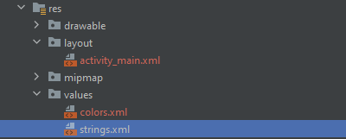
Values: strings
As best practice the text contained in a View: Buttons, TextView, EditText should not be editable directly through the text attribute but defined in a single XML file and edit directly inside it.
<resources> <string name="app_name">MyApp</string> <string name="hello_world">Hello World!</string> </resources>

Slide 13
Values: strings
avoid:
(activity_main.xml)
<Button
android:id="@+id/button" android:layout_width="wrap_content" android:layout_height="72dp" android:layout_gravity="center_horizontal“
android:text=“click"/>
To do:
(Strings.xml)
<resources> <string name="button_string">click</string> </resources>
(activity_main.xml)
<Button
android:id="@+id/button" android:layout_width="wrap_content" android:layout_height="72dp" android:layout_gravity="center_horizontal“
android:text=“@string/button_string"/>

Slide 14
Access Resources
Resources are compiled in a binary format and indexed with a unique ID. These IDs are stored in a Java class, named R, automatically generated with each change. By identifiers, the resources are accessible both from Java code and from other resources defined in XML:
Java: R.resource_type.resource_name;
R.id.button;
XML: @resource_type / resource_name.
@string/button_string

Slide 15
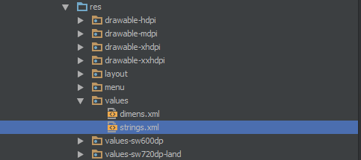
Alternative Resources
Almost every app should provide alternative resources to support specific device configurations. For instance, you should include alternative drawable resources for different screen densities and alternative string resources for different languages. During runtime, Android detects the current device configuration and loads the right resources for your application.
To create new resource folder, we can name: <resources_name>-<qualifier>.
<resources_name>: directory name of the corresponding default resources such as: values, drawable, mipmap, themes exc.
<qualifier>:name that specifies an individual configuration for which these resources are to be used such as: Language (en,fr,en),resolution(hdpi,mdpi,xhdpi,xxhdpi)

Slide 16
Concepts on screens

Slide 17
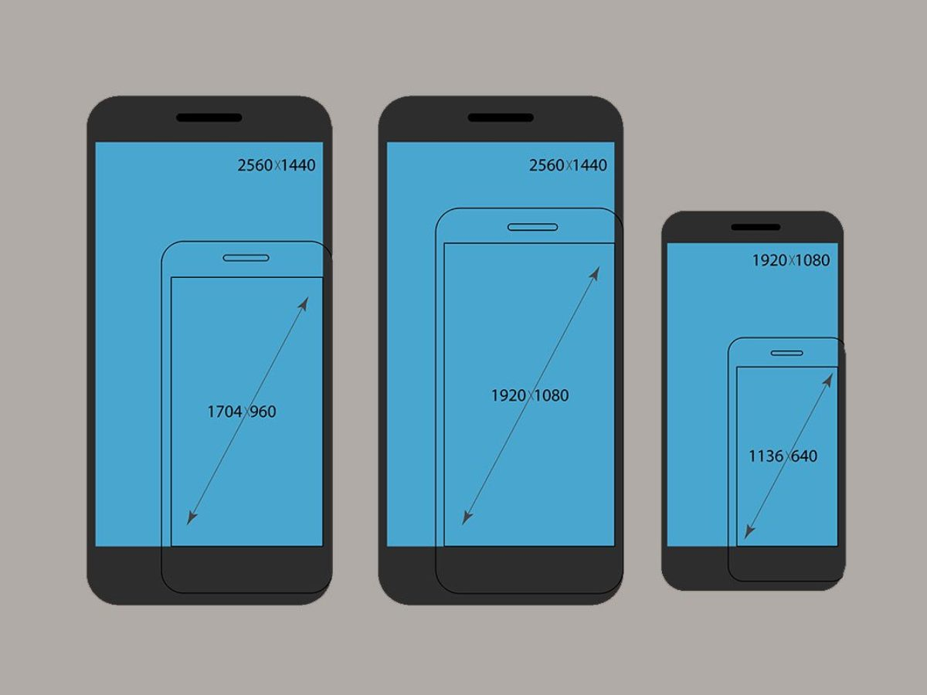
Screen Size
To show in our applications components such as Buttons, TextView and images it is important to understand with which measures are defined.
When we talk about screen size we talk about physical size measured along diagonal, we have 4 general sizes: small, normal, large and extra large.

Slide 18
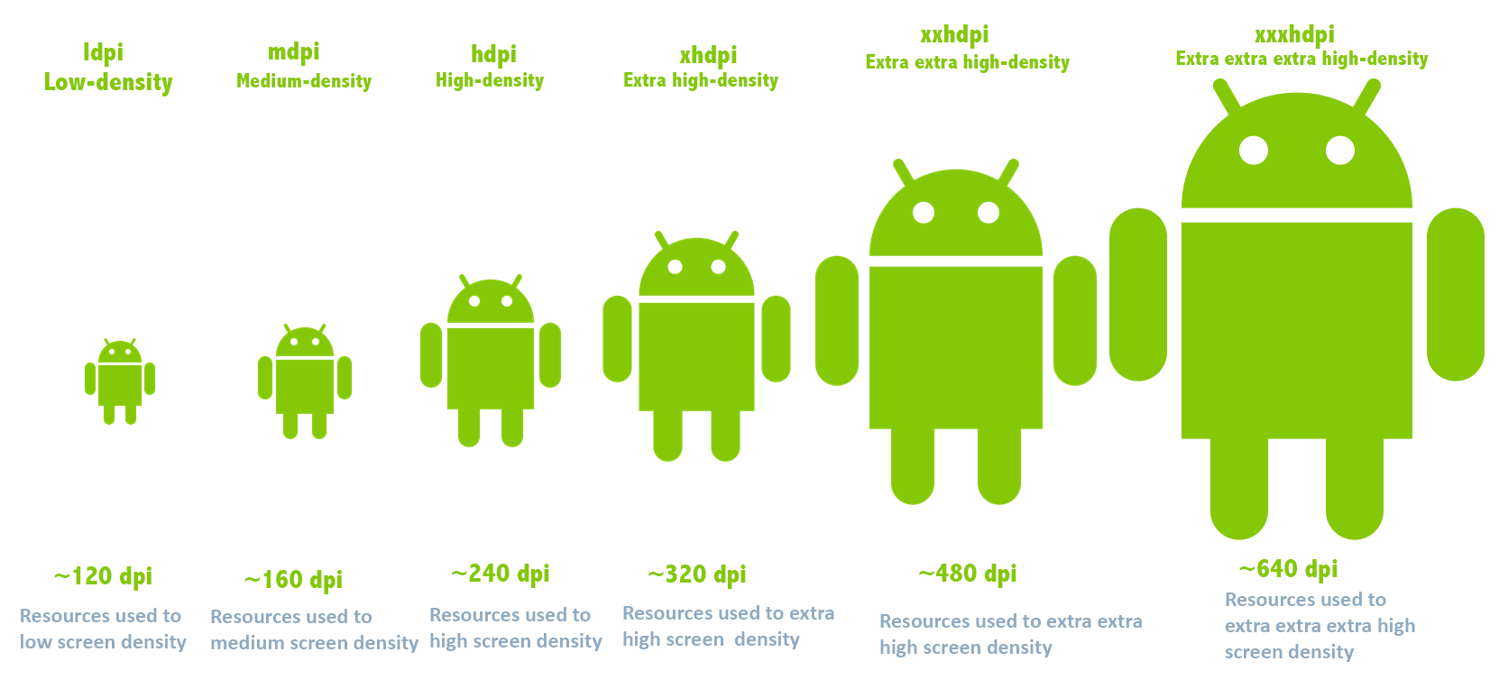
Screen Density
Number of pixels in an inch known as dpi (dots per inch) or ppi (pixels per inch).
There are 4 main categories:
ldpi: low density per inch
mdpi: medium density per inch
hdpi: high density per inch
xhdpi: extra high density per inch.
Every android device has different density size.

Slide 19
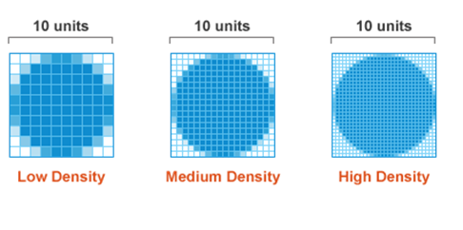
Screen Density
1 inch on low density we have 10 pixel
1 inch on medium density we have 20 pixel
1 inch on high density we have 30 pixel
if we use pixels as base unit, we must manage the difference density and different screen sizes
ex: 10 pixels are perfectly on ldpi, the mdpi is half size of screen and hdpi is ¼ of the screen.

Slide 20
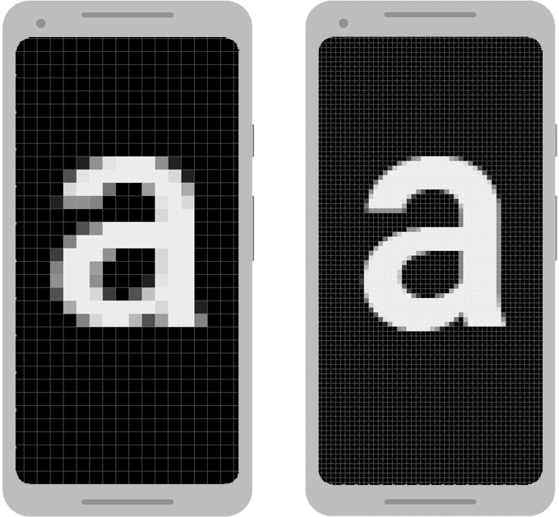
Issue: using pixels
Pixel are a minute area of illumination on a display screen, one of many from which an image is composed.
Defining dimensions with pixels is a problem because different screens have different pixel densities, so the same number of pixels may correspond to different physical sizes on different devices.

Slide 21
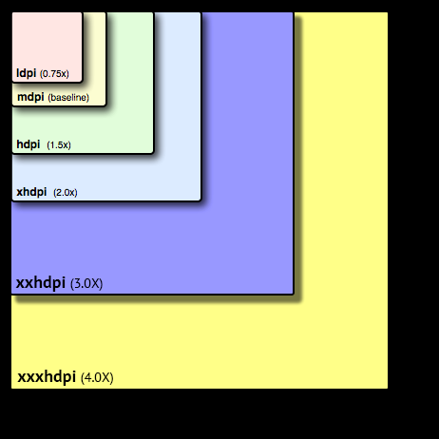
Solution: DPI
DPI (density independent pixel/device independent pixel) is a virtual pixel where we can define dimensions and position.
Android deals how big or small a pixel should appear across different device.
On Android all resources by default are considered for mdpi and scaled for other configurations Whenever we give unit in DP or device independent pixels what happens is for ldpi is multiplied by 0,75 to give us the actual pixels.
This is useful so we don't have to worry about how our drawable will look like with different densities on different screens.

Slide 22
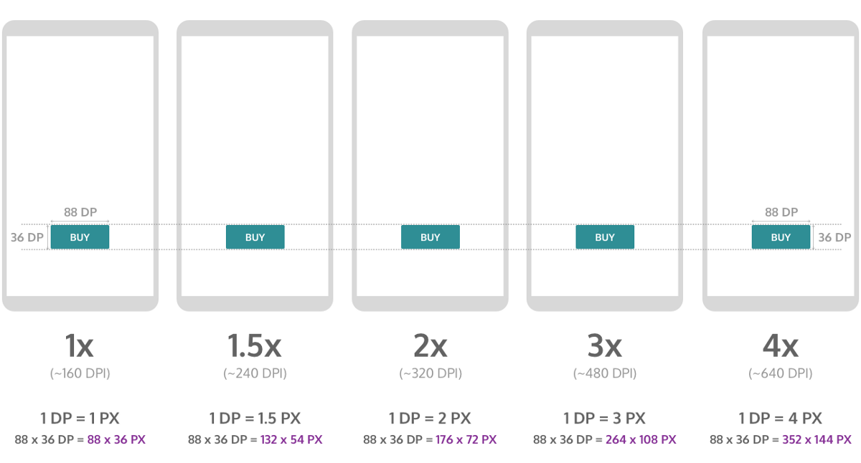
DPI conversion
At runtime, the system convert dp into px. px=dp*(dpi on our device/160)
When our app will be run on different devices, Android automatically applies the scaling factor to that particular device, and it make sure that the size of the user interface control is proportional to the size of the screen.

Slide 23
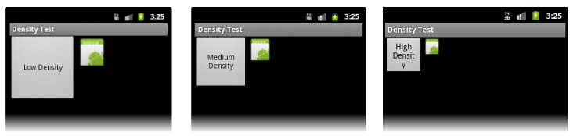
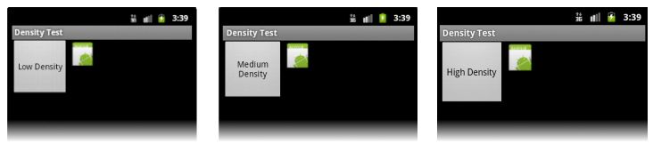
DPI
Without DPI:
With DPI:

Slide 24
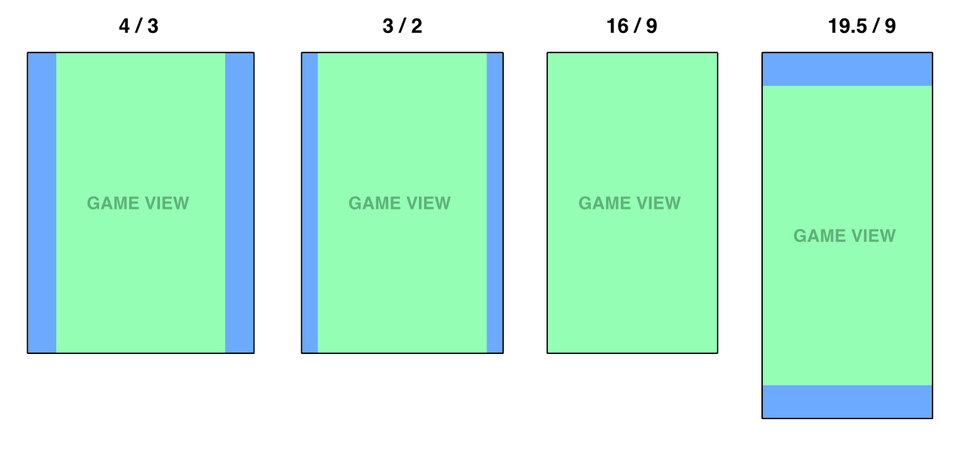
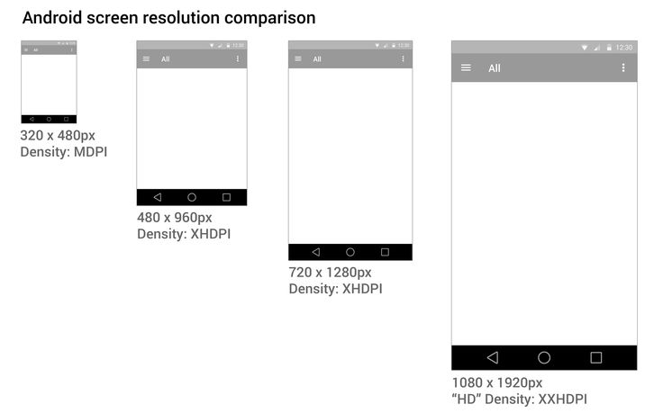
Further aspects
Screen resolution: number of pixels on the screen. In our developing we don’t work with screen resolution because it varies heavily in base of which device we use. We work only with screen size and screen density for cross device support.
Aspect ratio: ratio between width/height can be landscape or portrait.

Slide 25
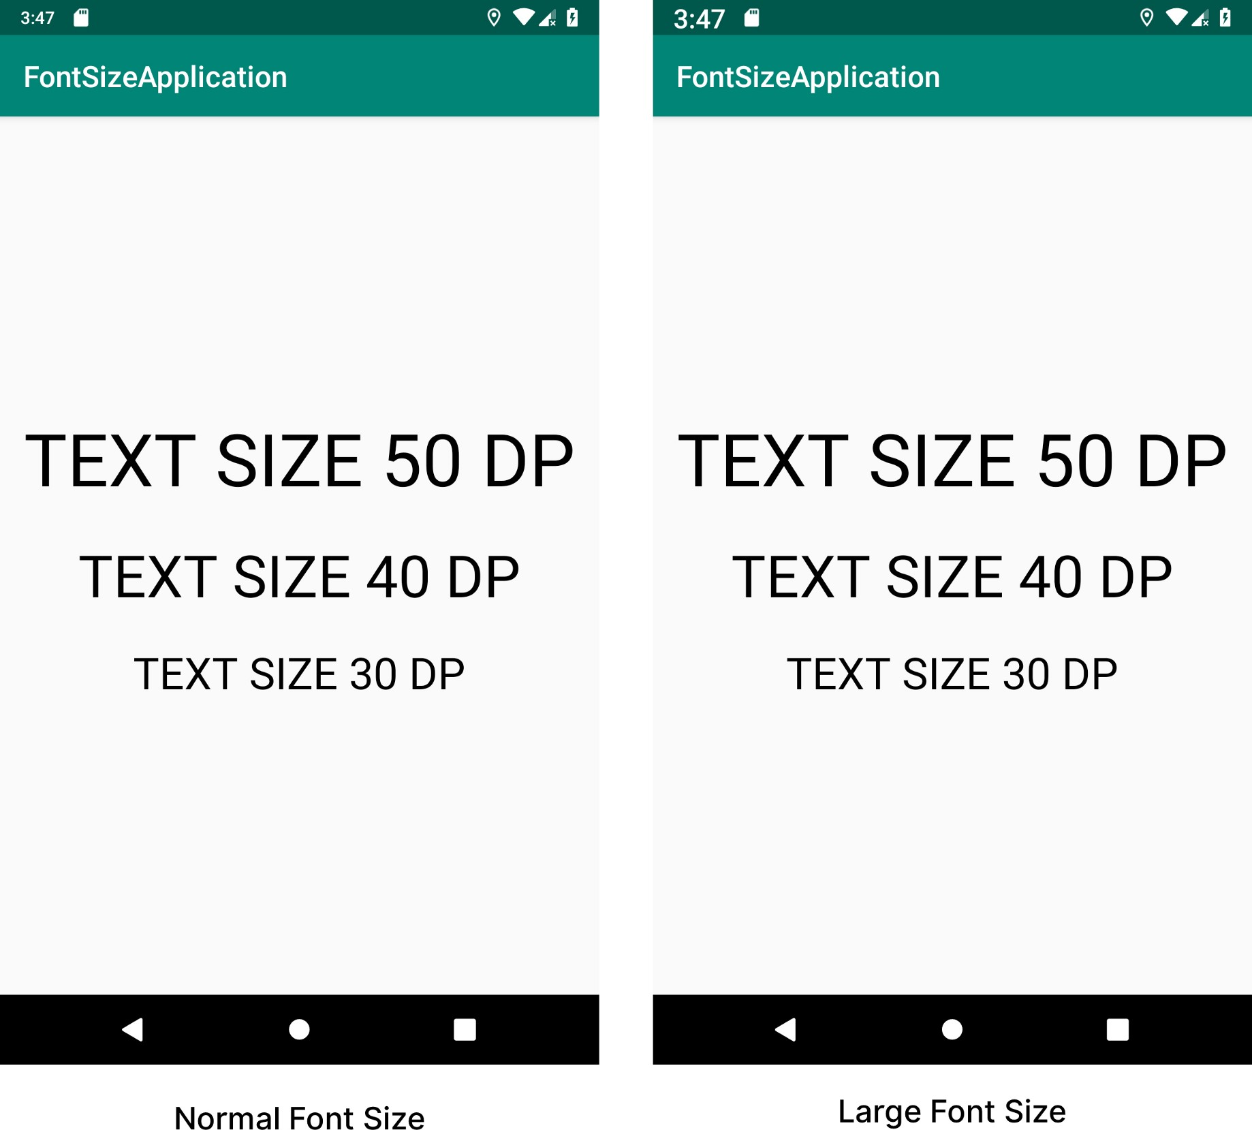
Scaled Pixel
Scaled pixel (sp) are virtual pixel according to density and user font preferences, is the same concept of DPI for fonts.
Whenever we using font, we want to be sure that it will be the same in proportion across different screen sizes, devices, densities sp are responsible to do it.
Morality:
Use dpi for normal sizes such as dimensions: wide of Button ,TextView.
Use sp only for fonts.

Slide 26
Unit of measure
So, when we talk about screens, we can have 6 units of measurement, but we do are not suppose use physical units:
mm: millimeters ✘
in: inch ✘
pt: 1/72 of inch✘
dp: based on 160 dpi screen and scaled appropriately for other devices ✓
sp: for fonts based on user font preference ✓
px: base on physical screen size. ✘

Slide 27
View & ViewGroup

Slide 28
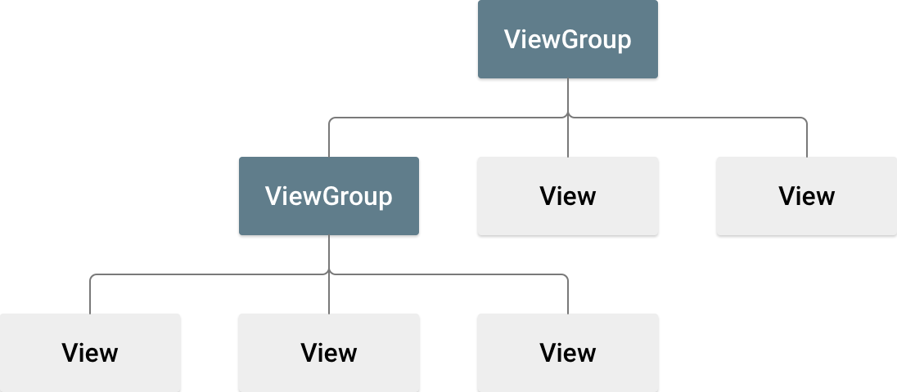
View & ViewGroup

Slide 29
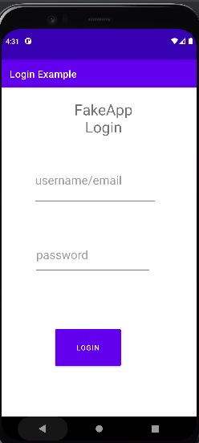
View & ViewGroup
View: all elements in the layout are built using a hierarchy of View and ViewGroup objects. A view is an object that takes rectangular area on the screen and is responsible for handling events in that area ex: button is a View, when is hit is respond in a way.
ViewGroup: An object that surrounds the view and is invisible and is responsible for holding Views in a certain design, a single ViewGroup can contains other ViewGroup. We can consider it as something that arranging other element that displays information.
Activity
ViewGroup
View

Slide 30
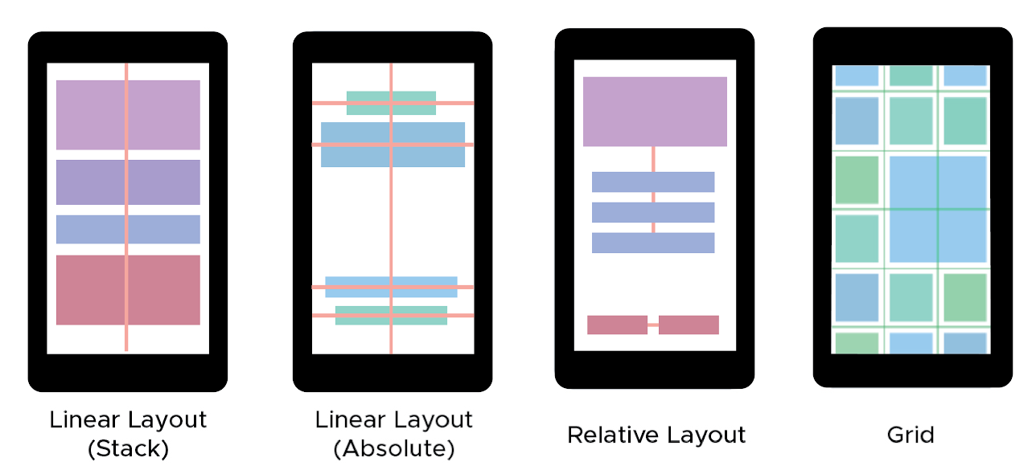
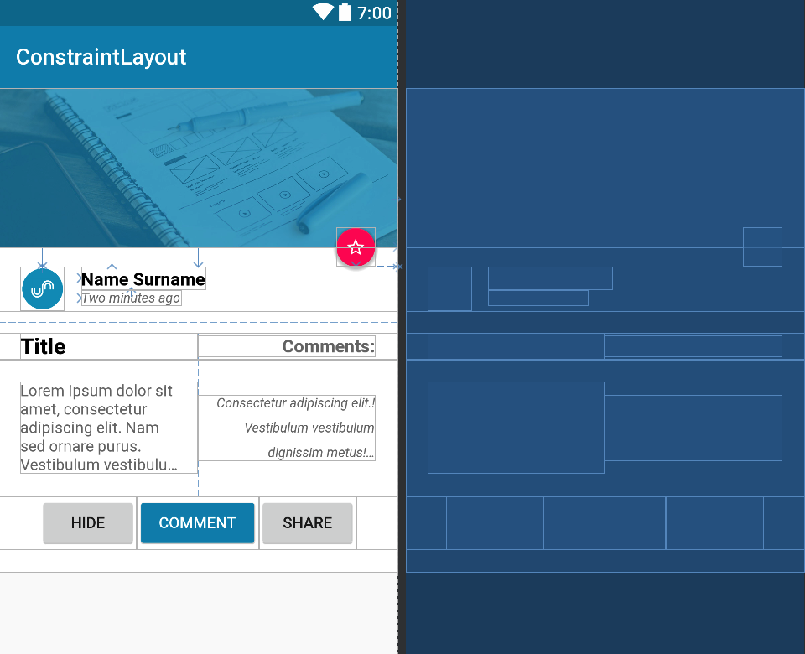
Layout
A layout defines the structure for a user interface in your app, such as in an activity. As we saw on Swing, we can have different layout such as: linear layout, relative layout, grid layout and constraint layout

Slide 31
Linear Layout

Slide 32
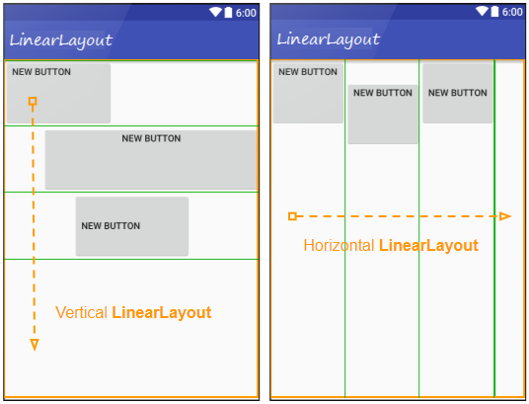
Linear Layout
Contains a set of elements that distributes sequentially from top to bottom (if defined with vertical orientation) or from left to right (if it has horizontal orientation, the default value). It is a very simple and rather natural layout for smartphone and tablet displays. Is responsible from placing the view side by side along different column and same row.
Note: layouts can contain one or more layouts

Slide 33
Create a Linear Layout
In our activity_name.xml open tag <LinearLayout> </LinearLayout>,which said to Android:
who is the root of the entire view structure.
who should be the object responsible for managing all the elements inside it.
When we define our UI appearance in XML, we always have a ViewGroup inside which all the other Views and ViewGroups are placed. The main ViewGroup is called View hierarchy root.
Every XML definition in Android for appearance requires the mentioning of the root.
<LinearLayout>
</LinearLayout>

Slide 34
Create a Linear Layout
Indicate the namespace where is coming from (automatically defined) is a URL.
Specify Layout dimension:
match_parent: takes all the available space.
wrap_content: It only occupies the space needed to be seen.
we must occupy the maximum space of screen.
Set orientation
<LinearLayout xmlns:android=http://schemas.android.com/apk/res/android”
xmlns:app="http://schemas.android.com/apk/res-auto" xmlns:tools=“http://schemas.android.com/tools”
android:layout_width="match_parent" android:layout_height="match_parent“
android:orientation="vertical"
/>
</LinearLayout>

Slide 35
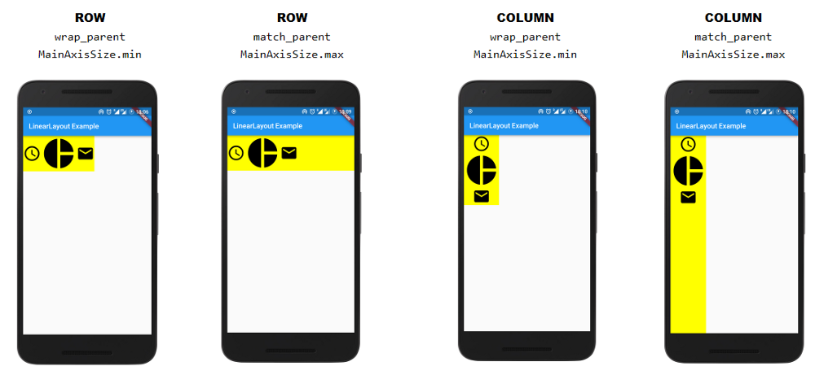
Comparison
match_parent: Object can take space as much as they want inside column or row.
wrap_content: Object take just essential
space to be saw on the screen inside column or row.

Slide 36
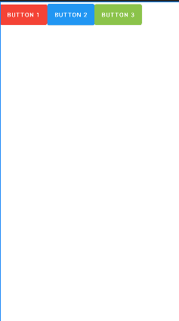
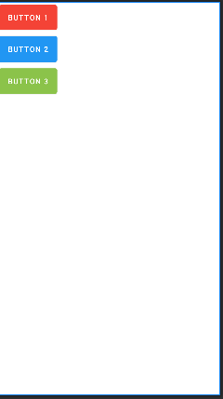
Create a Linear Layout
<LinearLayout xmlns:android="http://schemas.android.com/apk/res/android" xmlns:app="http://schemas.android.com/apk/res-auto" xmlns:tools="http://schemas.android.com/tools" android:layout_width="match_parent" android:layout_height="match_parent" android:orientation="vertical" tools:context=".HomeActivity"> <EditText android:id="@+id/editText“
android:layout_width="133dp" android:layout_height=“match_parent"
……
/> <Button android:id="@+id/loginButton“
android:layout_width=“33dp" android:layout_height=“match_parent"
….. /> <TextView android:id="@+id/textView“
android:layout_width=“wrap_content" android:layout_height=“68dp"
……. /> </LinearLayout>
specify the view, in terms of width and height.
Linear Layout support to way to arrange object:
horizontal: everything is going to come one near each other
vertical: everything is below each other.

Slide 37
Attributes

Slide 38
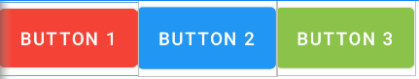
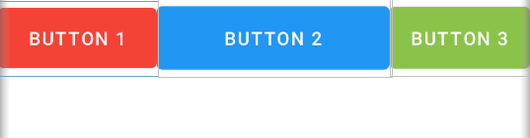
layout_weight
Each view has different attributes that can be used or not depending on the layout chosen. A supported attribute for the Linear Layout is the layout_weight.
This attribute assigns an "importance" value to a view in terms of how much space it should occupy on the screen. A larger weight value allows it to expand to fill any remaining space in the parent view. Child views can specify a weight value, and then any remaining space in the view group is assigned to children in the proportion of their declared weight. By default, layout_weight is zero.
Without
<Button android:id="@+id/Button1" android:layout_weight="2" android:text="Button 1" /> <Button android:id="@+id/Button2
android:layout_weight="10" android:text="Button 2" /> <Button
android:id="@+id/Button3 android:text="Button 3" />
With

Slide 39
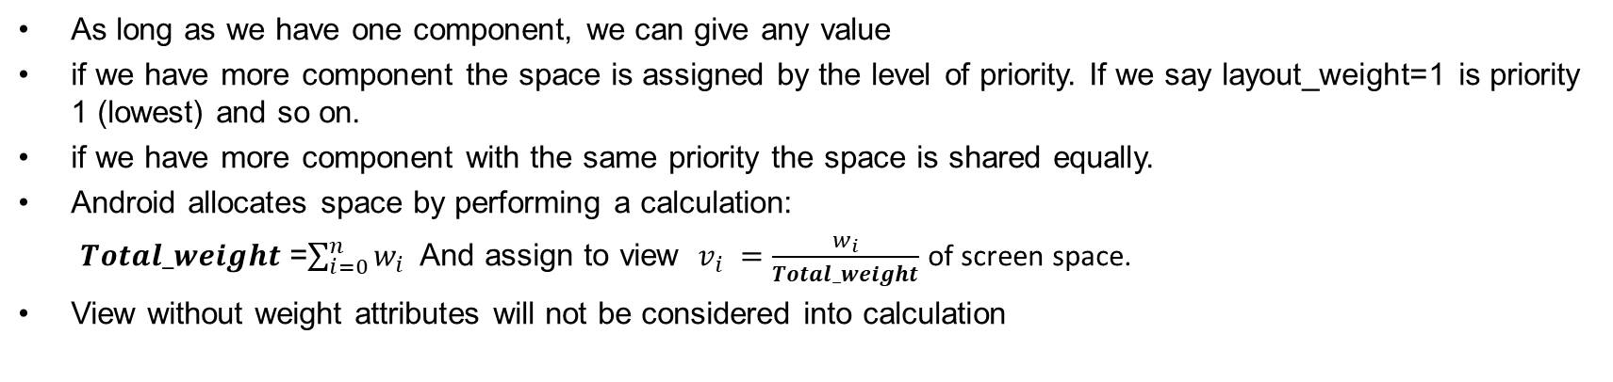
Note
As long as we have one component, we can give any value
if we have more component the space is assigned by the level of priority. If we say layout_weight=1 is priority 1 (lowest) and so on.
if we have more component with the same priority the space is shared equally.
Android allocates space by performing a calculation:
$Total_weight$=$\sum_{i=0}^{n}{w_{i}}$And assign to view $v_{i} =\frac{w_{i}}{Total_weight}$ of screen space.
View without weight attributes will not be considered into calculation
2
10
In our case $Total_weight$=12, Button1 takes $\frac{2}{12}$ of screen space , instead Button2 takes $\frac{10}{12}$of screen space, Button3 not considered.

Slide 40
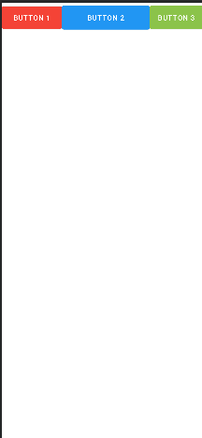
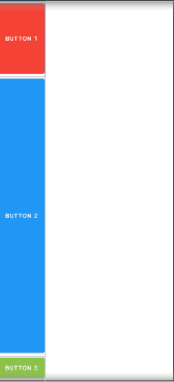
Note
When layout_weight is used, other attributes became redundant :
layout_height=layout_weight , in horizontal linear_layout.
layout_width=layout_weight, in vertical linear_layout.
For that reason, we must set layout_width/ layout_height= 0dp to avoid that Android perform other calculation since we use layout_weight.
Layout_weight depends on which orientation of linear layout we are working with:
Horizontal linear layout, modify view’s width
Vertical linear layout, modify view’s height

Slide 41
layout_gravity
Control where a View should appear inside its parent, if the view and the parent are both the same size, we not aspect to see any changes.
Gravity main xml values are:
left: Push object to the left of its container, not changing its size.
right: Push object to the right of its container, not changing its size.
center: Place the object in the center of its container in both the vertical and horizontal axis, not changing its size.
top : Push object to the top of its container, not changing its size.
bottom: Push object to the bottom of its container, not changing its size.
Also we can use a mix of them such as: top|left.
Not any values works for all layouts, instead having errors we do not see any changing on the screen.

Slide 42
layout_gravity: Horizontal
Element can be arranged on top, bottom in the same column. For a horizontal linear layout, layout_gravity values do not change columns.
Values | Applicable?
layout_gravity=”bottom” | ✓
layout_gravity=”top” | ✓
layout_gravity=”center” | ✓
layout_gravity=”center_vertical” | ✓ at column, not on the center of the screen.
layout_gravity=”center_horizontal” | ✘ Not supported change column, nothing error is showed, after that View came back to the default location.

Slide 43
layout_gravity: Vertical
Object are allowed to move in the same row, but not change column.
Values | Applicable?
layout_gravity=”bottom” | ✘
layout_gravity=”top” | ✘
layout_gravity=”center” | ✘
layout_gravity=”center_vertical” | ✘
layout_gravity=”center_horizontal” | ✓

Slide 44
gravity
Control where the contents of the View should appear inside the View ex: the text of textView. The view must be bigger than the content inside to see the effect of it, if the View is wrap_content is height and width we never will see any effect.
Values are:
android:gravity=”right”
android:gravity=”left”
android:gravity=”center_vertical”
android:gravity=”center”
android:gravity=”bottom|right”
Left
Top
Center_horizontal
Right
Center_vertical
Center
Bottom
Notes:
Left

Slide 45
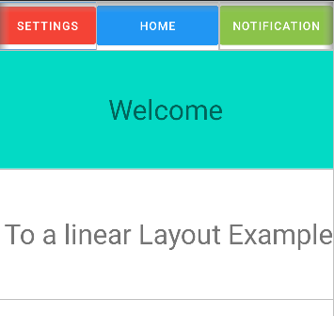
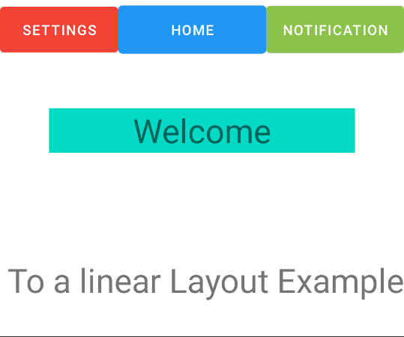
layout_margin & padding
layout_margin: margin is the space outside the view between itself and its container.
padding: space inside the view between its boundaries and its content.
The Welcome TextView has a padding of 50dp which correspond to its height.
The Welcome TextView is distant from all other 50dp views always remaining within its linear layout line.

Slide 46
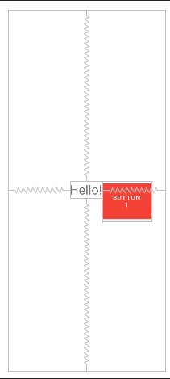
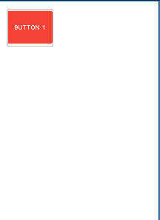
Note
If we have a single View, Android padding applied to the parent looks the same as the Android margin applied to the child.
We can apply both the attributes
<RelativeLayout android:layout_width="match_parent" android:layout_height="match_parent" android:layout_margin="20dp" android:orientation="vertical" > <Button android:id="@+id/Button1" android:text="Button 1" android:layout_width="wrap_content" android:layout_height="85dp" android:padding="20dp" android:textSize="15sp"/>
…….. </RelativeLayout>
<RelativeLayout android:layout_width="match_parent" android:layout_height="match_parent" android:orientation="vertical" > <Button android:id="@+id/Button1" android:layout_width="117dp" android:layout_height="96dp" android:backgroundTint="#F44336" android:layout_margin="20dp" android:text="Button 1" android:textSize="15sp" /> </RelativeLayout>
<RelativeLayout android:layout_width="match_parent" android:layout_height="match_parent" android:orientation="vertical" android:padding="20dp"> <Button android:id="@+id/Button1" android:layout_width="117dp" android:layout_height="96dp" android:backgroundTint="#F44336" android:text="Button 1" android:textSize="15sp" /> </RelativeLayout>

Slide 47
Relative Layout

Slide 48
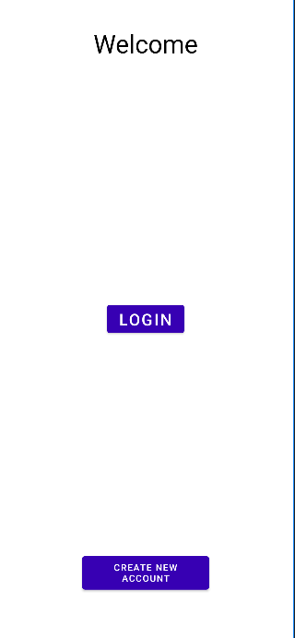
Relative Layout
Is used to specify where the View will be placed with respect to some other View or parent
Allows 2 things:
place our view with respect to itself, that is with respect to the relative layout or the parent which is called
place the view with respect to some other view which has been placed already on the screen has a TextView and a Button
<RelativeLayout xmlns:android="http://schemas.android.com/apk/res/android" xmlns:tools="http://schemas.android.com/tools" android:layout_width="match_parent" android:layout_height="match_parent" tools:ignore="MissingDefaultResource"> <TextView android:id="@+id/Welcome" android:layout_width="wrap_content" android:layout_height="wrap_content" android:layout_above="@id/login_button“
…… android:padding="20dp" android:text="Welcome" android:textAlignment="center" android:textColor="@color/black" android:textSize="35sp" /> <Button android:id="@+id/login_button" android:layout_width="wrap_content" android:layout_height="wrap_content“ android:text="Login“
…… android:textSize="23sp" /> <Button android:id="@+id/create" android:layout_below="@id/login_button" android:layout_alignParentBottom="true”
…… android:text="Create new account" android:textSize="13sp" />
</RelativeLayout>

Slide 49
Attributes
Most of relative layout attributes takes View’s id of which we are referring to instead boolean values. attributes such as layout_gravity do not exist in relative layout, because we have full customization of where we want to place or view on the screen. A relative layout that is not the root and is nested inside some other layout may have a layout weight.
Attributes | Description
android:layout_alignParentBottom=”true” | aligns the view at the bottom of the parent layout
android:layout_alignParentLeft=”true” | aligns the left view to the parent layout
android:layout_alignParentRight=”true” | aligns the right view to the parent layout
android:layout_alingParentTop=”true” | aligns the top view to the parent layout
android:layout_above=“@ViewId" | place the view above another view
android:layout_below=“@ViewId" | place the view below another view
android:layout_toLeftOf="@ViewId" | place the view to the left of another view
android:layout_toRightOf="@ViewId" | place the view to the right of another view

Slide 50
Example
Focusing on a basic login Screen, first we add a Welcome TextView and we can align it where we want, after we add the login button that will be appear on the top left, if we want put it below the text, we must use android:layout_below and give to each view an Id in order to refer you.
@+ tells that we are defined something for the first time
@ tells that we are referring to something not new and already exists.
<TextView android:id="@+id/Welcome" android:layout_width="wrap_content" android:layout_height="wrap_content" android:layout_alignParentLeft="true" android:layout_alignParentRight="true" android:layout_marginBottom="155dp" android:padding="20dp" android:text="Welcome" android:textAlignment="center" android:textColor="@color/black" android:textSize="35sp" />
<Button android:id="@+id/login_button" android:layout_width="wrap_content" android:layout_height="wrap_content" android:layout_centerInParent="true" android:layout_below="@id/Welcome" android:layout_centerVertical="true" android:layout_marginTop="160dp" android:backgroundTint="@color/purple_700" android:text="Login" android:textSize="23sp" />

Slide 51
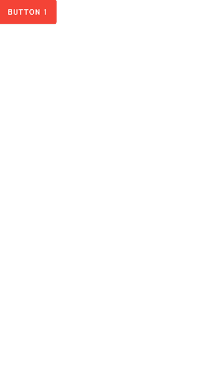
Issue
Assume we create one button and one TextView and we want that the second one to be above the other one, so we can write something like:
<Button
android:id="@+id/Button1"
android:layout_width="wrap_content"
android:layout_height="58dp"
android:backgroundTint="#F44336"
android:text="Button 1" />
<TextView
android:layout_width="wrap_content"
android:layout_height="wrap_content"
android:layout_above="@id/Button1"
android:textSize="40sp"
android:text="Hello!"/>
Relative Layout by default place View on Top left corner of our screen, in this way we are trying to saw that the Textview should be above the screen, so android create the object but not draw it.
Where the TextView gone?
But we see this:

Slide 52
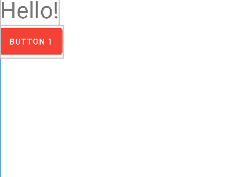
Solution
Do the opposite thing: specify the button must be below the TextView instead
<Button
android:id="@+id/Button1"
android:layout_width="wrap_content"
android:layout_height="58dp"
android:backgroundTint="#F44336"
android:text="Button 1"
android:layout_below="@id/TextView"/>
<TextView
android:id="@+id/TextView"
android:layout_width="wrap_content"
android:layout_height="wrap_content"
android:textSize="40sp"

Slide 53
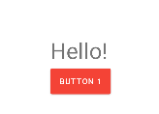
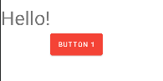
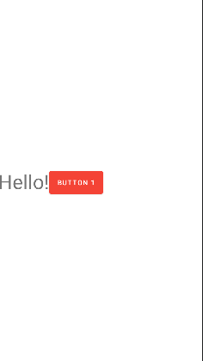
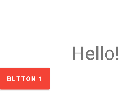
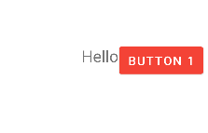
Alignment between Views
<Button
……
android:layout_alignLeft="@id/TextView" android:layout_below="@id/TextView"/>
<Button .....
android:layout_below="@id/TextView"
android:layout_toRightOf="@id/TextView"/>
<Button
……
android:id="@+id/Button1"
android:layout_below="@id/TextView"
android:layout_alignTop="@id/TextView"
android:layout_toRightOf="@id/TextView"
/>
<Button
… android:layout_below="@id/TextView"/>
<Button
android:layout_alignBaseline="@id/TextView"
android:layout_toRightOf="@id/TextView"/>
Make Textview and Button text alligned
Attributes | Description
android:layout_alignTop="@ViewId"
android:layout_alignBottom="@ViewId"
android:layout_alignLeft="@ViewId"
android:layout_alignRight="@ViewId"
android:layout_alignBaseline="@ViewId"

Slide 54
Table Layout

Slide 55
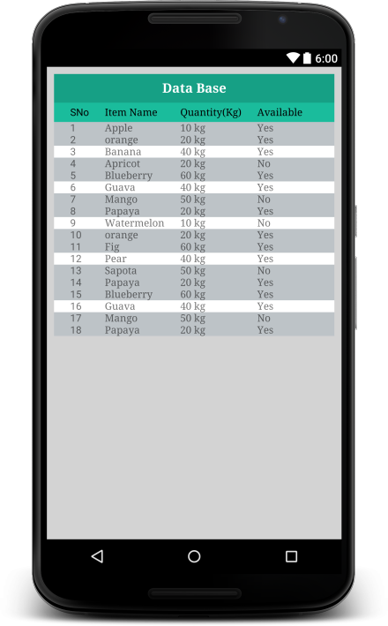
Table Layout
Is a layout used for arranges Views in rows and columns. To define a new row, we can use a Java class TableRow or using the table row XML tag. There’s no need to define columns because once we define a table row when we add views in it automatically, is created a new column on the same row.
Each view we place inside the table row forms a column
Table layout is a sublcass of horizontal linear layout
table row width and height values do not matter, also for the views inside of it
note:
Table row is always MATCH_PARENT in width and WRAP_CONTENT in height and we cannot change it.
Number of columns inside the TableLayout is decided by the TableRow having the maximum Views
the TableLayout adjust the columns based of the number of element inside the row
column width is automatically adjust based on the size of the column with maximum width
we place a View outside TableRow and inside TableLayout. A View outside a TableRow and inside TableLayout has a match_parent width and wrap_content height by default

Slide 56
Attributes
Attribute | Apply to | What does it do? | What values can it have?
android:stretchColumns | TableLayout | Stretch either 1 column or a set of columns or all columns (index starts 0) | android:stretchColumns=”0” (stretch the first column) android:stretchColumns=”1,2” (stretch the first,second column equally) android:stretchColumns=”*” (stretch all column equally )
android:shrinkColumns | TableLayout | Remove unnecessary extra space from column and shrink it (index starts at 0) | android:shrinkColumns=”0” (shrink the first column) android:shrinkColumns=”1,2” (shrink the first,second column equally) android:shrinkColumns=”*” (shrink all column equally )
android:layout_span | Any child View inside Table Row | Makes the view span multiple columns (in terms of width) specified by the number in layout_span | android:layout_span=”2” (make the View 2 columns wide)
android:layout_column | Any child View inside Table Row | Specify the index of the column number inside which our view should appear | android:layout_column=”2” (make the View appear inside the column with index 2) (example) space between buttons
android:collapseColumns | TableLayout | Hide the column specified by index | android:layout_collapseColumns=”2” android:layout_collapseColumns=”0,1”

Slide 57
Grid Layout

Slide 58
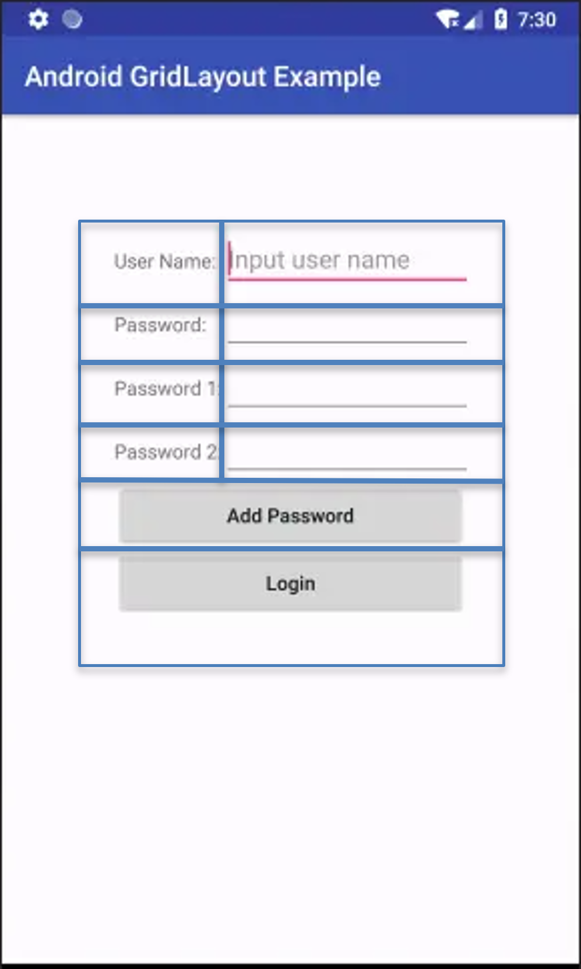
Grid Layout
Considered a TableLayout upgrade, arranges Views in rows and columns,for its definition require to specify row and column number with following attributes: android:rowCount, android:columnCount.
GridLayout allows to:
Control if a View takes more than one row
Control if one View takes more than one column
Specify in which row and column a View will be placed
Unique feature offered by Grid Layout: Multiple Views can be in the same column and overlap
Also, we don’t have to specify width and height for View inside GridLayout is WRAP_CONTENT by default . (but android studio gives error, so we must specify it)

Slide 59
Attributes
Attributes | Description
android:layout_row=“index“ | Place a View in a specific row (index starting from 0)
android:layout_column=“index“ | Place a View in a specific column (index starting from 0)
android:layout_layout_gravity=”fill | fill_vertical | fill_horizontal ” | Sets the gravity of the View or Layout relative to its parent. Size View’s depends not only for layout_gravity but also for neighbor cells in the same row or column. Becomes necessary when we using the following 2 attributes.
android:layout_columnSpan=“index" | make it span multiple columns
android:layout_rowSpan=“ index“ | make it span multiple rows
android:orientation="horizontal | vertical " | fill all the column before passing on the next row Vertical: fill all row before pass to next column Horizontal: fill all column before pass to next row

Slide 60
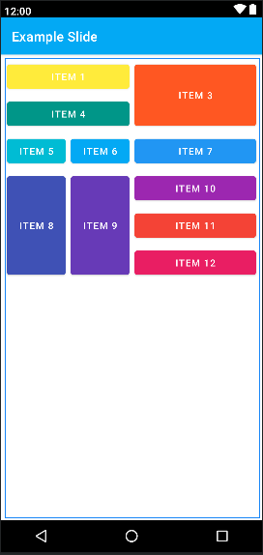
Example
Imagine we are designing an application that shows products that can be purchased, we can approximate the structure of the screen like the one in the figure.
As in the TableLayout objects are added in the next column until they fill the row, but thanks to GridLayout we can put an object in a specific position. To give more space to a View we can use attributes:
android:layout_rowSpan, android:layout_columnSpan, but alone nothing will change if we do not also use the attribute layout_gravity to expand the “representation” space of the View. Let’s see how the element 3 and 8 was defined:
<Button android:layout_width="wrap_content" android:layout_height="wrap_content" android:layout_row="0" android:layout_column="2" android:layout_rowSpan="2" android:layout_gravity="fill" android:backgroundTint="#FF5722" android:text="Item 3" />
<Button android:layout_height="wrap_content" android:layout_width="wrap_content" android:text="Item 8" android:layout_rowSpan="3" android:layout_gravity="fill" android:backgroundTint="#3F51B5" />

Slide 61
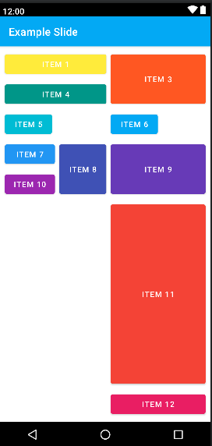
Space View
GridLayout give possibility to have additional space using a special View called Space View that will occupy one position into the Grid.
Note: after item 6 there is no SpaceView object, to increase its dimension we must use properly layout_gravity attributes.
Tip:
determine in advance the position of the objects as changes made later items already placed can greatly change the appearance of the Views inside the grid.
Pay attention on layout_gravity values.
<GridLayout android:layout_width="match_parent" android:layout_height="match_parent" android:columnCount="3" android:rowCount="10" android:layout_margin="5dp">
<Button android:layout_height="wrap_content" android:layout_width="wrap_content" android:layout_columnSpan="2" android:text="Item 4" android:layout_gravity="fill" android:backgroundTint="#009688" /> <Button android:layout_height="wrap_content" android:layout_width="wrap_content" android:text="Item 5" android:layout_row="5" android:layout_column="0" android:backgroundTint="#00BCD4" />
…… <Space></Space> <Button android:layout_height="wrap_content" android:layout_width="wrap_content" android:text="Item 11" android:layout_gravity="fill" android:backgroundTint="#F44336" android:layout_column="2"/>
</GridLayout>

Slide 62
Constraint Layout

Slide 63
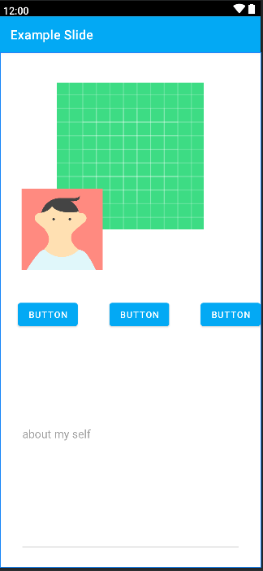
Constraint Layout
Usually when we use linear or relative Layout, we insert thing in a nested deep hierarchy introducing much time for execution and affecting performance.
Constraint Layout Introduced in 2016 its scope is to create View hierarchy as flat as possible, we can imagine it as sort of flexible relative layout with more feature and with more user friendliness, so we don’t have to write on xml .
Each view has 4 anchor point (View’s edges), with click+canc we can delete it, only click one of them we can drag the arrow to another view anchor point or Parent.
Basic rules: Each view must have 1 vertical and 1 horizontal constraint since the emulator will run, if the View is not well constraint will be moved to a different place where it was in design Android view.( can move to the origin 0,0 left top corner of the screen).

Slide 64
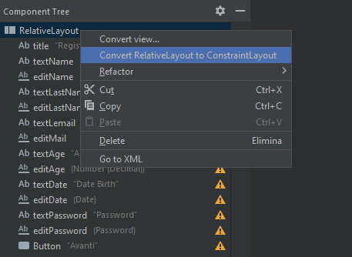
Layout editor feature
Every layout seen so far can be convert into a constraint layout by clicking the root element on Component Tree inside layout editor.
clear all constraints
Infer constraints automatically gives constraint in base of the View placing, is useful to finish layout after we have set most of constraint (is not a short way to constraint all View objects!)
Autoconnect (disabled by default )every time we add more view try to constraint it, but nothing happens unless the view is centered, and gives only horizontal constraint with the parent and no other view
Appear after we click on one view: constraint the selected view in relation of existing View, if we click two or more View, we have more option available

Slide 65
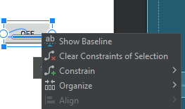
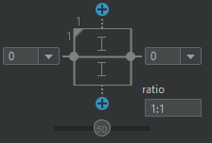
Layout editor feature
Right click we can show the View’s baseline and aligned to other view baseline.
Take an image view, constraint it, give match constraint value for width(0dp) and click on triangle on left top corner, so you can now modify the aspect ratio, be careful to device rotation.

Slide 66

Chain
A chain is a group of views that are linked to each other with bi-directional position constraints. For example, figure 2 shows two views that both have a constraint to each other, thus creating a horizontal chain. Is easy to create a chain selecting more views to align vertically or horizontally, we can modify the chain inside editor in packed, spread and spread inside or on XML file editing the only the selected view has constrainHorizontal_chainStyle attribute.
if we use match_parent, view will increase proportionally to give enough space to each one inside the chain

Slide 67
Attributes
Attributes | Description
app_layout_constraintWidth_default=”wrap| spread” | Spread: if we move the Views bounded to View with that attribute it will stretch or shrink Wrap: even if we move the Views Width doesn’t change
layout_constraintWidth_min | Set min View width
layout_constraintWidth_max | Set max View width
constraintWidth_percent=”%” | Takes width available in base of the percentage given of the parent not based on given constraints
constraintHeigth_percent=”%” | Takes height available in base of the percentage given of the parent not based on given constraints

Slide 68
Helpers
Guideline: is A view with visibility set on gone, so it can be used to constraint other view without see a vertical or horizontal line on the screen, Can be used to give margin to all view and not singular to each one.
Barriers: similar to guideline but its position is defined by other Views in it not from the barriers itself. Barriers doesn’t create a nested View, instead a set of attributes called constraint_referenced_ids=”textViewid1, textViewid2” indicates which views are inside of it. if A view Visibility is set to gone, barrier can stay in the same position we can change that behavior setting barrierAllowsGoneWidgets=”false”.
Group: control the visibility and elevation of the referenced views. Such as Barriers have constraint_referenced_ids=”view1,view2” without creating a nested View.

Slide 69
Widget

Slide 70
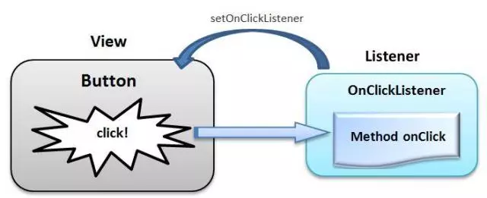
Button
To change Activity is not enough to use an intent to perform this operation, we need a Button and understand how should behave following an event. As we saw on Java Swing, we can handle by a listener.

Slide 71
1-way:Java & XML
Inside XML file where button is defined, we add an attribute that tells our XML code: when the button is clicked doSomething should happened.
<Button android:id="@+id/button" android:layout_width="160dp" android:layout_height="89dp" android:text=“Click" android:onClick=“doSomething"/>

Slide 72
1-way:Java & XML
doSomething is a method inside Activity class that takes a View argument (a button Is a View subclass),and inside we declare what behavior our button should have. In our case we declare an Intent
public void onClick(View view) { Intent intent=new Intent(this,NameOfOtherActivity.class); startActivity(intent); }
Issue: Android always try to separate code with graphics, this is an easy way to implement a clickListener but create a bind that between two worlds, if we create a new method do handle the button o change the name and forgett do appropriate changes the app will crush.

Slide 73
2-way: OnClickListener
If Activity needs to handle click event they can implement OnClickListener interface, override onClick method without having to add anything to the XML file respecting the separation practice of Android.
public class MainActivity extends AppCompatActivity implements OnClickListener { @Override protected void onCreate(Bundle savedInstanceState) { super.onCreate(savedInstanceState); setContentView(R.layout.activity_main); } @Override public void onClick(View view) { } }

Slide 74
2-way: OnClickListener
public class MainActivity extends AppCompatActivity implements OnClickListener { @Override protected void onCreate(Bundle savedInstanceState) { super.onCreate(savedInstanceState); setContentView(R.layout.activity_main);
Button button=(Button)findViewById(R.id.button);
button.setOnClickListener(this); } @Override public void onClick(View view) { Intent intent=new Intent(this,SecondActivity.class); startActivity(intent); } }
<Button android:id="@+id/button" android:layout_width="wrap_content" android:layout_height="wrap_content" android:text="Button" />
Inside onCreate method we instantiate a Button and get a reference of XML object contained on resource id named “button”. After we set the clickListener that will be our Activity Class.

Slide 75
2-way:multiple Button
public class MainActivity extends AppCompatActivity implements OnClickListener { @Override protected void onCreate(Bundle savedInstanceState) { super.onCreate(savedInstanceState); setContentView(R.layout.activity_main);
Button btn1=(Button)findViewById(R.id.btn1);
btn2.setOnClickListener(this);
Button btn2=(Button)findViewById(R.id.btn2);
btn2.setOnClickListener(this); } @Override public void onClick(View view) {
…
} }
@Override public void onClick(View view) { if(view.getId()==R.id.btn1) { Intent intent=new Intent(this,SecondActivity.class); startActivity(intent); } if(view.getId()==R.id.btn2) { Intent intent=new Intent(this,ThirdActivity.class); startActivity(intent); } }
If Activity has more than one Button we can use the same method and depending on the case, change the behavior according to which button is pressed

Slide 76
2-way:Issue
If an activity contains several button, the addition of other produces the addition of lines to define the button and the continuous modification of the onclick method
public void onClick(View view) { if(view.getId()==R.id.btn1) { Intent intent=new Intent(this,SecondActivity.class); startActivity(intent); } if(view.getId()==R.id.btn2) { Intent intent=new Intent(this,ThirdActivity.class); startActivity(intent); }
if(view.getId()==R.id.btn3) { Intent intent=new Intent(this, FourthActivity.class); startActivity(intent); }
..
if(view.getId()==R.id.btnN) { Intent intent=new Intent(this,NActivity.class); startActivity(intent); }
}
Button btn1=(Button)findViewById(R.id.btn1);
btn2.setOnClickListener(this);
Button btn2=(Button)findViewById(R.id.btn2); btn2.setOnClickListener(this);
Button btn3=(Button)findViewById(R.id.btn3);
btn3.setOnClickListener(this);
Button btn4=(Button)findViewById(R.id.btn4);
btn4.setOnClickListener(this); …
Button btnN=(Button)findViewById(R.id.btnN);
btnN.setOnClickListener(this);

Slide 77
3-way:Anonimous Class
Typical Android implementation of a click listener involves the use of anonymous classes, instead implementing onClickListener interface, we can use a HOC class for only one button and override onClick method.
protected void onCreate(Bundle savedInstanceState) { super.onCreate(savedInstanceState); setContentView(R.layout.activity_main);
Button btn=(Button)findViewById(R.id.button);
btn.setOnClickListener(new View.OnClickListener(){ @Override public void onClick(View view) { Intent intent= new Intent(MainActivity.this,SecondActivity.class); startActivity(intent); } });
}

Slide 78
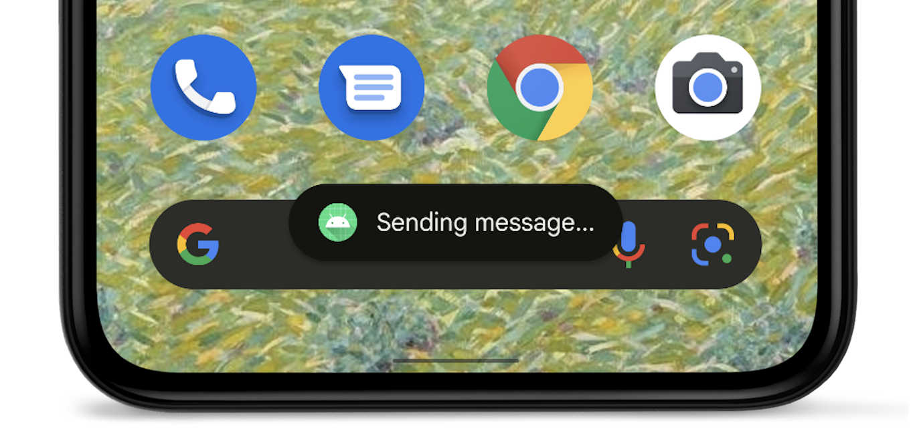
Toast
A toast provides simple feedback about an operation in a small popup. It only fills the amount of space required for the message and the current activity remains visible and interactive. Toasts automatically disappear after a timeout.
If your app is in the foreground, consider using a snackbar instead of using a toast. Snackbars include user-actionable options, which can provide a better app experience.
If your app is in the background, and you want users to take some action, use a notification instead.

Slide 79
Implementation
Create Toast: Toast toast=Toast.makeText (Context c, CharSquence text, int duration)
Context : passing context with getApplicationContext
int duration: could be Toast.LENGTH_SHORT, Toast.LENGTH_LONG those are static parameter inside Toast class.
Show the Toast: toast.show()
If we show multiple toasts, are queued and displayed as soon as the current one disappears.
Toast Position: toast.setGravity(int gravity, int xdist, int ydist)
example:
toast.setGravity(Gravity.LEFT,0,0)
toast.setGravity(Gravity.RIGHT,0,0)
toast.setGravity(Gravity.BOTTOM | Gravity.RIGHT,0,0).
when we add values to X and Y we must remember that they are referred to the origin given by the gravity parameter

Slide 80
Custom Toast
Android offers the chance to create a custom Toast following this easy steps:
Create Toast Java object using a constructor
Toast toast=new Toast(getApplicationContext());
Set optional property such as duration and gravity
Get a reference of LayoutInflater (Instantiates a layout XML file into its corresponding View) with getLayoutInflater();
Create separate layout for the toast, and convert XML reference into a Java one
View appearence=layoutInflater.inflate( int resource, ViewGroup root);
resource = toast id layout
ViewGroup = layout parent id , can be found with findViewById().
set View inside toast and show it

Slide 81
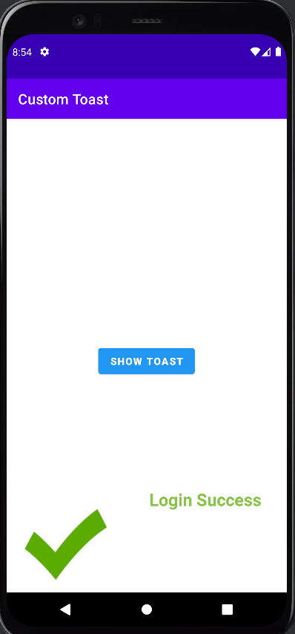
Custom Toast
Toast toast=new Toast(getApplicationContext()); toast.setDuration(Toast.LENGTH_LONG); toast.setGravity(Gravity.BOTTOM,0,0); LayoutInflater layoutInflater=getLayoutInflater(); View appearence=layoutInflater.inflate(R.layout.toast_layout,(ViewGroup) findViewById(R.id.root)); toast.setView(appearence); toast.show();
<LinearLayout android:layout_width="match_parent" android:id="@+id/root" android:layout_height="match_parent"> <ImageView android:id="@+id/imageView" android:src="@drawable/spunta_verde“
…. " /> <TextView android:id="@+id/textView" android:text="Login Success“
……./> </LinearLayout>

Slide 82
Customize text with TextView
As we saw TextView are user interface element which shows the text to the user. Also, we can customize our text by this following attributes.
Attributes | Description
android:textColor | put specify color we must make sure il compatible for latest and previous android version best way to give color is using color.xml where we declared our color.
android:textStyle | values bold, italic or bold | italic
android:type | values normal, sans, serif, monospace
android:shadowColor | values any color
android:shadowDx | Giving floating point value to increment the fading
android:shadowDy | Giving floating point value for increment fading (distance from text origin)

Slide 83

Change text size
A common practice for those who program professionally to give the text size requires that a variable be defined in an xml resource with its value, in this way you can make changes quickly and easily without having to edit multiple files.
1
create a new xml file
2
Define our values
<resources> <dimen name="smaller">10sp</dimen> <dimen name="small">20sp</dimen> <dimen name="normal">30sp</dimen> <dimen name="big">50sp</dimen> <dimen name="bigger">100sp</dimen> </resources>
3
Change any text size by textSize attributes ad accessing to values with:
android:textSize="@dimen/….."

Slide 84
Typeface
The Typeface class specifies the typeface and intrinsic style of a font. This is used in the paint, along with optionally Paint settings like textSize, textSkewX, textScaleX to specify how text appears when drawn. We can create a font with this methods:
Typeface.create(String familyName, int style)
Typeface.createFromAsset(AssetManager manager, String path)
Typeface.createFromFile(File path or String path)
Implementation
Download font https://www.fontsquirrel.com/fonts/list/popular
Create folder named “assets and insert font file
Select View that we want to use Custom Font
Create Typeface object using Typeface.create that contains the custom font
Set Typeface of the View to use this object
Note
Font format should be TTF or OTF
Huge fonts will be downloaded along with the app affecting its size
Custom fonts are accessed in code
Use always Typeface.create methods to load personal Font
if the Font is invalid, Android will use the system default fonts
Take care of copyright issues with protected fonts
public class MainActivity extends AppCompatActivity {
@Override
protected void onCreate(Bundle savedInstanceState) {
super.onCreate(savedInstanceState);
setContentView(R.layout.activity_main);
TextView t1=findViewById(R.id.welcome_text);
Typeface myfont=Typeface.createFromAsset(getAssets(),"font/poppins/Poppins-Black.otf");
t1.setTypeface(myfont);
}
}

Slide 85
EditText
A user interface element for entering and modifying text. When you define an edit text widget, we must specify the input type.
Attributes | Description
android:minLines | Makes the View this many lines tall, we can give any integer value
android:maxLines | Maximum number of lines to display
android:maxLength
android:hint | Display hint to user before typing
android:inputType Values: “textCapSentences” capitalize each word after every space “number” make enter only number ”date” make enter only date ”textCapWords” capitalize every word ”textPassword” “textUri” Text that will be used as a URI Values | Validation of user input by allowing only certain values to be entered through the keyboard

Slide 86

Issue
inputType is a very useful attribute for validating user input, but it may not be enough. Let’s imagine we designed a Sign up screen. Despite the use of inputType values no one can prevent the user from entering invalid values:
Invalid input
android:inputType="textPersonName"
Invalid input
android:inputType="textCapSentences"
Invalid input
android:inputType=“numberDecimal"

Slide 87
Solution: TextWatcher
Java interface that allow us to validate user input. When an object of this type is attached to an Editable (EditText superclass), its methods will be called when the text is changed.
create a link between EditText on XML and Java
make even the ActivityMain class implementing TextWatcher interface, or a separate class that handles the responsibility of managing text changes
implement all TextWatcher methods
add TextChangeListener to the View

Slide 88

TextWatcher
Since the user may not enter anything, the conversion from string and number could generate errors at runtime, so we have to surround the code with a try-catch block.
try{ for (int i = 0; i < editable.length(); ++i) { char c = editable.toString().charAt(i); if (Character.isDigit(c) == false) { Toast.makeText(context, "insert only numbers", Toast.LENGTH_SHORT).show(); } } int n = Integer.parseInt(editable.toString()); System.out.println(n); if (n < 0 || n > 110) { Toast.makeText(context, "invalid age number", Toast.LENGTH_SHORT).show(); } } catch (NumberFormatException e) { e.printStackTrace();
}

Slide 89

CheckBox
Checkboxes allow the user to select one or more options from a set.
When the user selects a checkbox, the CheckBox object receives an on-click event.
To define the click event handler for a checkbox, add the android:onClick attribute to the <CheckBox> element in your XML layout. The value for this attribute must be the name of the method you want to call in response to a click event. The Activity hosting the layout must then implement the corresponding method.

Slide 90

Implementation
Create checkbox
Nothing happens when you check or uncheck the option by default
Implement View.OnClickListener
onClick method is called each time the checkbox is either checked or unchecked
Determine if the box is checked using isChecked() method
Separate the code in base of which state is the checkbox.
protected void onCreate(Bundle savedInstanceState) { … checkBox=findViewById(R.id.checkbox); checkBox.setOnClickListener(new View.OnClickListener() { @Override public void onClick(View v) { if(checkBox.isChecked()) { Log.d("Debug","I'm checked"); } else { Log.d("Debug","I'm unchecked"); } }}); } }

Slide 91

Toggle Button
Used when there are two very specific options, and the user should be able to switch between them easily and effortlessly.
ex: switch to light or dark mode. Toggle button generates events like any other buttons when is set or unset . Using method onCheckedChangeListener
Implementation
Create a ToggleButton
by default, nothing happens
implement the CompoundButton.onCheckedChangeListener
onCheckedChangeListener methods is called every time user changes the Toggle
Use the boolean parameter to determine if the Toggle is set
public void onCheckedChanged(CompoundButton buttonView, boolean isChecked)
CompoundButton: name of button clicked by the user
isChecked: indicates if was set or unset

